Slide 1

Music Classification with Spectrograms
Prepared by: José Chacón (Pontifical Catholic University of Peru)
Jean P. Correa (National University of Colombia)
Ana Mayora (University of Zaragoza)
Gabriela Vega (Peruvian University of Applied Sciences)
Optimal Tortoises Pod / Augmented Tortoises
TA: Javier Ordoñez / Project TA: Rutvi Prajapati

Slide 2

INTRODUCTION
Background
Music Information Retrieval (MIR) is an interdisciplinary field of research which has applications such as genre classification, mood detection and chord recognition. For music classification, a Mel spectrogram is usually chosen as a visual representation of an audio file.
Proposed Idea
In this work, our goal is to study how well a CNN (Convolutional Neural Network) performs a music genre classification through audio signals represented by Mel spectrograms.
For the purpose of this research we have chosen the GTZAN dataset (2001).
We hypothesized that the application of regularization techniques (as Early Stopping or Data Augmentation) in a CNN can improve the performance of the music genre classification over a basic CNN architecture consisting of six convolutional layers.
Music Classification with Spectrograms Augmented Tortoises

Slide 3
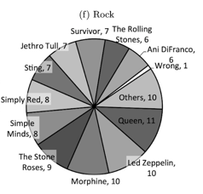
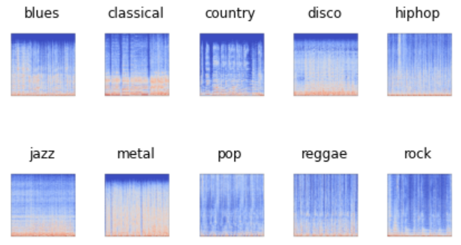
Spectrograms & Music Genre
A Mel spectrogram is a specific type of spectrogram (representation of the frequencies of a signal along time) in which the frequencies are represented according to human perception using a log scale.
GTZAN Dataset
1000 Song Samples (.wav / Mel spectrograms)
10 Genres
https://www.analyticsvidhya.com/blog/2021/06/music-genres-classification-using-deep-learning-techniques/
Music Classification with Spectrograms Augmented Tortoises

Slide 4
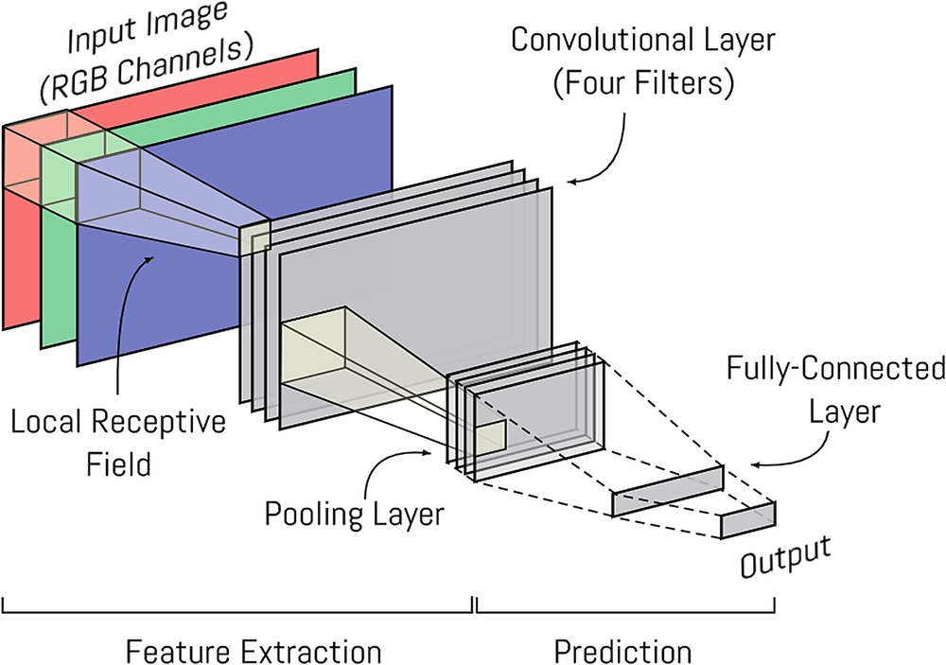
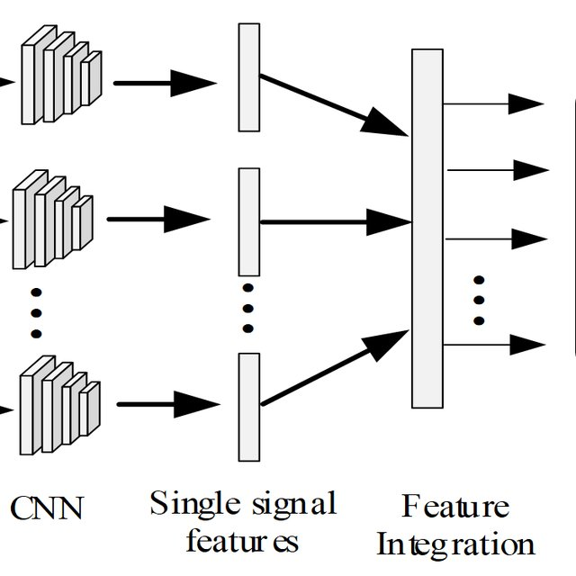
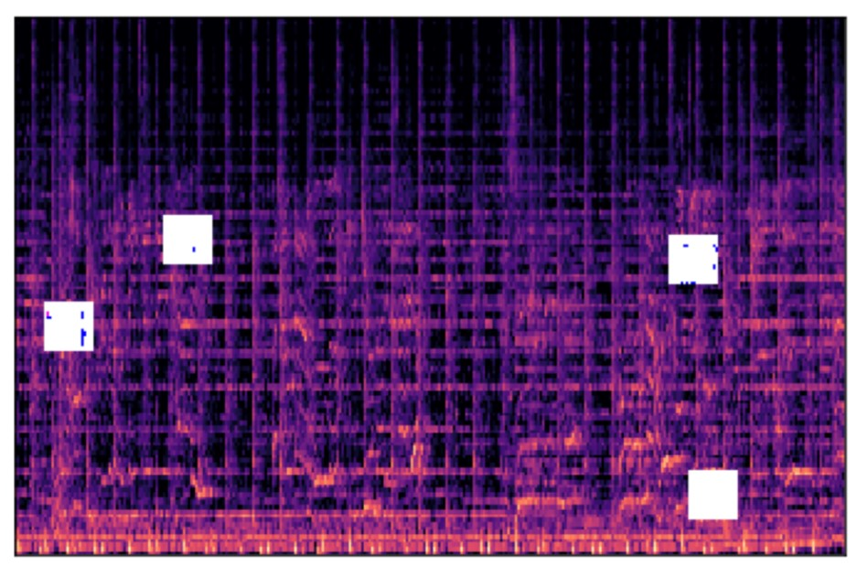
METHODOLOGY
Baseline
6 Convolutional Layers / Kernel Size: 3, 5 / Padding: 0, 1
Vanilla CNN
2 CNN
2 CNN + Regularization techniques
Early Stopping
Data Augmentation
Music Classification with Spectrograms Augmented Tortoises
Notes:
2 CNN: Kernel Size diferentes.

Slide 5
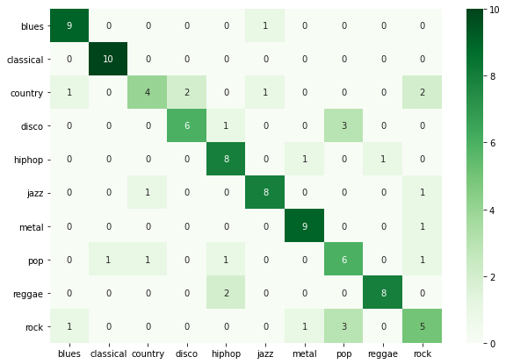
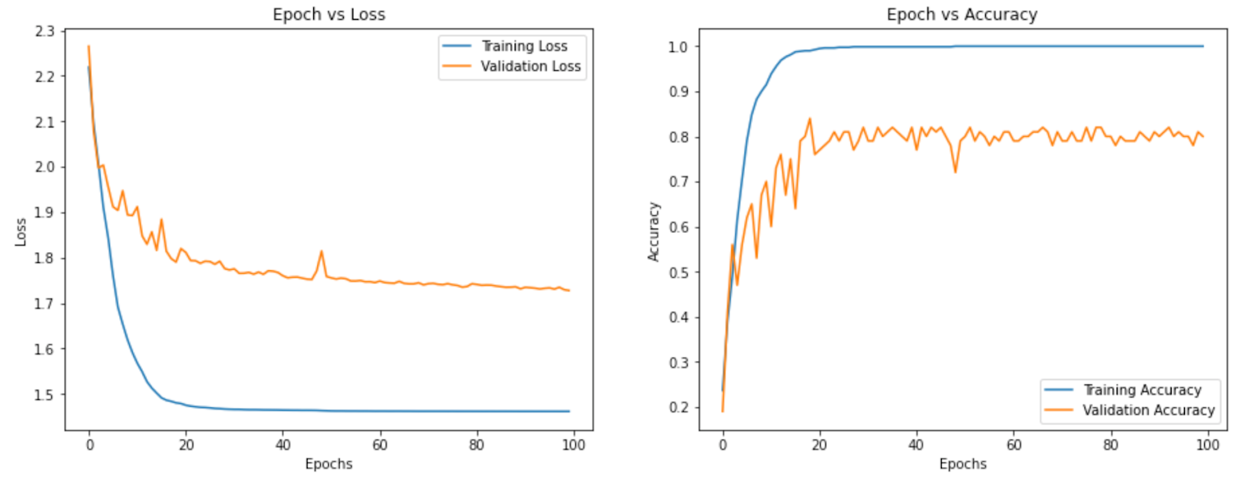
RESULTS
Best Accuracy Model Results
Confusion Matrix
Best Accuracy was obtained when regularization techniques were applied to the 2 CNNs design.
Data Augmentation do not work as well as we expected.
Some shared patterns between genres difficult the model to generalize well (pop - rock, pop - disco).
Music Classification with Spectrograms Augmented Tortoises
Notes:
Data Augmentation: con 4 se obtuvieron los mejores sultados. No aumento el accuracy como lo esperado.Otros intentos (12,10) - 1 15s
Pop - Disco - Usually Fast Tempo
Genre too much variety. Could be a interest research idea.

Slide 6

CONCLUSIONS
FUTURE WORK
The obtained validation results for either one or two CNNs models are around the 70% accuracy range.
When applying early stopping or data augmentation to the two CNNs model we have got a better accuracy, obtaining 80% validation accuracy with early stopping.
Then, we conclude that the use of regularization techniques alongside the union of two CNNs with different kernel size can help us achieve a fairly high accuracy in music genre classification tasks.
Transformers.
Transfer Learning.
Other datasets.
Extend it to other MIR tasks
Recommendation.
Mood recognition.
Generation.
Music Classification with Spectrograms Augmented Tortoises

Slide 7

CONCLUSIONS
Thank you!
¡Gracias!
The obtained validation results for either one or two CNNs models are around the 70% accuracy range.
When applying early stopping or data augmentation to the two CNNs model we have got a better accuracy, obtaining 80% validation accuracy with early stopping.
Then, we conclude that the use of regularization techniques alongside the union of two CNNs with different kernel size can help us achieve a fairly high accuracy in music genre classification tasks.
Q & A
Music Classification with Spectrograms Augmented Tortoises

